Slide 1
The Novel Unit: Fairytale Rewrite

Slide 2
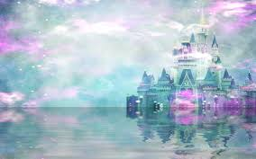
What do you know about the tale of Sleeping Beauty?

Slide 3
Politically Correct Bedtime Stories
Different lens to look at the fairytale.
What ways can you retell a fairytale?

Slide 4
The Project
You and a partner will rewrite a classic fairytale in a variety of ways

Slide 5
First thing…
You and your partner will need to read the original tale (NOT WATCH THE DISNEY MOVIE)
Three major authors:
Hans Christian Andersen
Charles Perrault
Brothers’ Grimm

Slide 6
Required (Part 1)
Brief write-up about the author and context/history of the original tale
Briefly summarize the story with key plot points and characters
You may choose to do this in a list, a story arch, or any other creative format you wish.
Will include this in your rewrite

Slide 7
Required (Part 2)
Must have same characters, plot
Things you can do:
Change the ending
Change the perspective
Create a new character
Create a new setting
Modernize the story

Slide 8
Details
750-1000 words (story only)
20 points in process
Due 10/25 by 10pm
Just submit one per partner pair, and use your last names as the submission title

Slide 9
Task
Each person in your group will read a different story
You will then share how that tale differs from the original
If you have not read the original, do a quick internet search
Purpose: what ways can you retell a fairytale?

