Slide 1
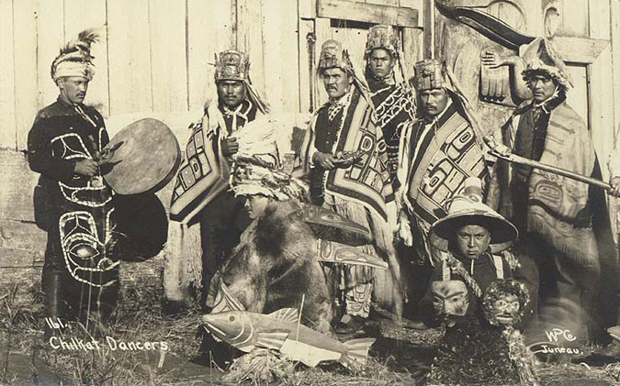
Imagine you are a wealthy Native American in the Pacific Northwest before white Europeans have arrived. You and your neighbor have a quarrel over local
fishing rights.
How do you resolve
the dispute?
Now, If you chose a violent method, how would you resolve the dispute without using violence?

Slide 2
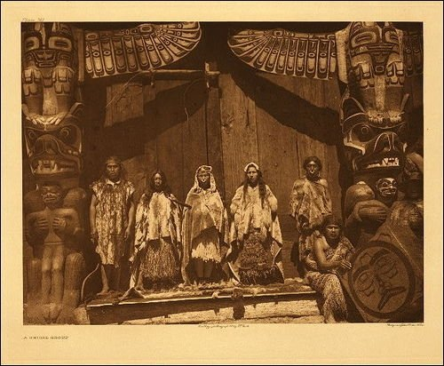
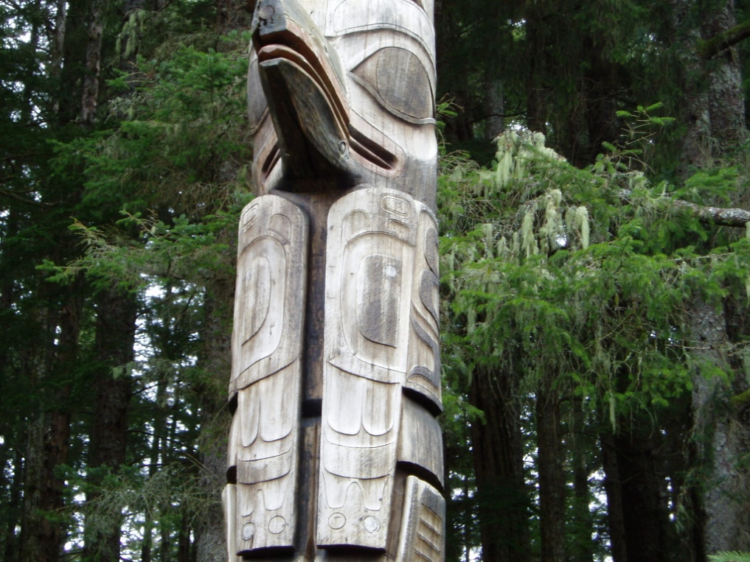
Potlatch
Demonstrates thoughts on wealth, etc.
Also demonstrates the style the Native Americans would use when trading.

Slide 3
Native Americans of the
Pacific Northwest

Slide 4
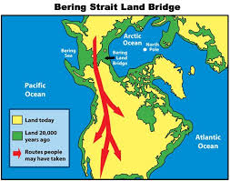
Earliest Inhabitants
Ice Age (30,000 Years Ago) Northwest was very forbidding
Glaciers in Puget Sound, Erupting Volcanoes, brutal weather
First inhabitants probably went across Bering Land Bridge about 30, 000 years ago, gradually walked south in search of game- formed earliest settlements 14, 000 years ago in NW.

Slide 5
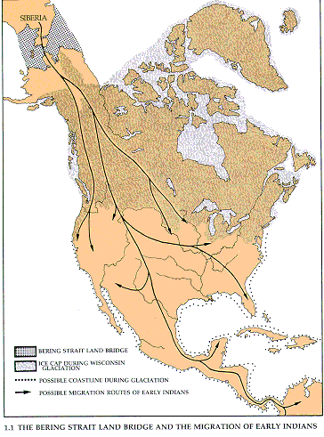
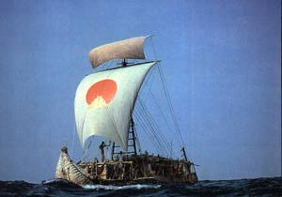
How Did They Get Here?
Walking Theories:
Ice- Huge thick glaciers would have bridged Bering Strait
Land- So much ice would have lowered sea level, and exposed what is now bottom of the Bering Sea
Floating Theories
Thor Heirdall and the Kon Tiki, and the Ra II – primitive sailing vessels that made it across the Pacific, and Atlantic Oceans respectively.

Slide 6
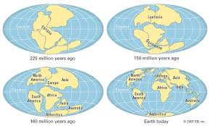
How Did They Get Here?
Continental Drift
Continents used to be closer together millions of years ago
But drifted apart long before humans evolved, which explains why no humans originally in Western Hemisphere

Slide 7
Geologic Incident Native Americans Saw
The retreat of the glaciers from the area
The horrific (but awesome) destruction caused by the glacial dams giving way, releasing Lake Missoula and Columbia River
The flooding of Puget Sound by the Pacific Ocean
Mt. Mazama- once a 12000 foot mountain, blew up and filled with water, became Crater Lake
The entire history of Mt. St. Helens- a mountain grew from nothing to 10,000 feet, and then blew up
The building up of Mt. Rainier to 17,000 feet, then blew up current height of 14,000 feet

Slide 8
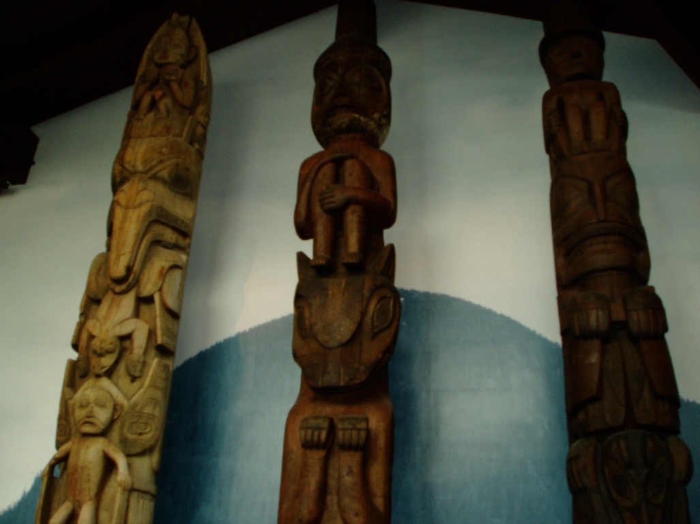
Three classifications of PNW Indians
Coastal or Pacific Coastal Indians – Nootka
Great Plateau (and Alaskan) Indians – Cayuse, Walla Walla
Great Basin Indians – Shoshoni

Slide 9
Coastal Tribes
E.g. the Colgulles, Upaquas, Siletz, Tillamook, Tulatin, Makah, Chinook, Pullyalup, Summi, Muckleshoot, Nisqually.
Relatively easy life
Temperate Climate
Ample food from oceans and rivers
Thus lived in more permanent settlements
Though did travel a fair amount to trade, go to war, etc.
The favored method of transport was the water, and they used large canoes to get around.
Also tended to keep them living near some body of water
Tended to live in small, isolated groups

Slide 10
Plateau Indians
E.g. Nez Perce, Spokane, Colville, Flathead, Walla Walla.
Rougher natural environment
Hotter in summer, colder in winter
Less readily available food
Thus were nomadic
Lived in larger, roaming bands
Constant skirmishes over territory

Slide 11
Politics
Coastal
Tribes and chiefs
Chief and his courts was usually the richest guys
Slavery- generally captured women and children in wars- More slaves= greater prestige
Note- different than chattel slavery of American South- could be freed and not determined by race
Plateau
Also had chiefs, though often this was chosen by bravery, rather than material wealth.
Chief was president and chief justice in one, also sometimes spiritual leader.
More communal structure than coastal- tended to pool goods- though people didn’t have much, because moved around a lot

Slide 12
Language
Coastal
Sedentary nature caused there to be great difference in languages, though as time went on (especially after the arrival of whites), there developed “trade jargons” like Chinook- that only had a 100 words or so (like “how much?”) but were known by most.
Plateau
Broader range did allow for wider comprehension of language- still no written language.

Slide 13
Economics
Coastal
Very practiced and enthusiastic traders- traded manufactured goods as well as food, clothing.
Upon arrival of whites, metals and manufactured items highly prized.
Plateau
Much less trading because had less to trade- though did trade horses, etc. Did also make elaborate ceremonial clothing.

Slide 14
Religion
Coastal
Anamistic: meaning nature based and personal
Polythesitic: belief/worship of many Gods
Burial Ceremonies Important- Dead often put above ground, to avoid animals carrying them off
Plateau
Anamistic- meaning nature based and personal
Centered around shaman- spiritual leader
Dangerous to be him- blamed for bad luck

Slide 15
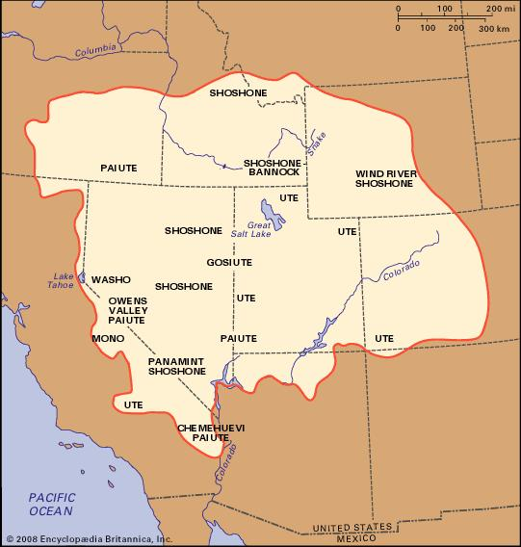
Great Basin Indians
Had none of the civilized luxuries of the Plateau and Coastal Indians
Survival was biggest challenge
No real government or politics or common language
Religion still anamistic
Economics is a matter of survival
Nomadic, used teepees

Slide 16
Native Americans and the West

Slide 17
More movement
After Civil War, U.S. begins expanding again
5 civilized tribes-Cherokee, Choctaw, Chickasaw, Creek, Iroquois, have Oklahoma
Many other Native Americans see writing on the wall and move farther West
Gold rush in California, statehood for CA and OR, homesteading, and the railroads on quicken this process

Slide 18
Reservations
Legally tribes were sovereign nations within US and had standing, diplomacy, etc., hence all the treaties
Actuality they had no rights.
U.S. starts to relocate them on reservations, Oklahoma 1st in 1840s → idea then expands to West
Problem is they either
a.) keep shrinking the size of the land promised
b.) get really horrible land or
c.) add more tribes to land so amount becomes too small and fights start
Plus many tribes have sacred land and this is not it

Slide 19
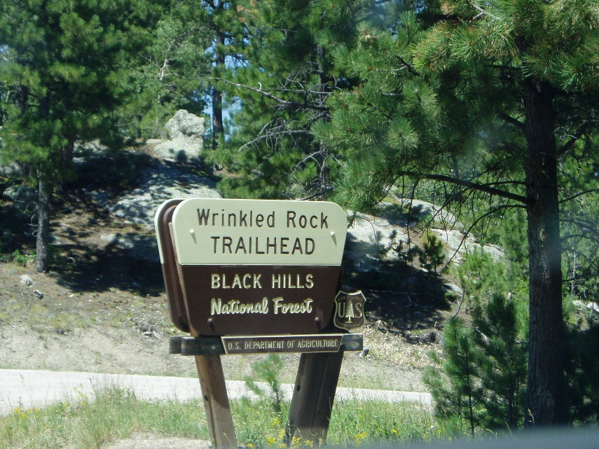
War time
Cheap treaties (like Medicine Creek) occurred to get land for people or railroad; most involved relocation = upset natives
Mass slaughter of buffalo by settlers with guns throws off food, hunting, tribal patterns, established territory, etc. = more upset natives
And seizure of sacred land like
Black Mountain Hills of Sioux
in South Dakota = even more upset natives
Lots of upset natives = war
time

Slide 20
Native American Tribes Project

Slide 21
Directions:
You and your advertising team have been hired by a historical Native American tribe from the Pacific Northwest to develop a campaign to recruit new members. After spending a few days researching that tribe, its culture, and history, your group will be expected to advertise that tribe to the class.
You will put the main events into a visual presentation accompanied by a timeline and an advertising poster. Your presentation should be no more than 7 minutes long and will act as the class’ lecture on that particular tribe—there will be no additional lecture, so be sure to be as comprehensive as possible.
Each group will also write a short (1 page) “factbook” entry. Each member of your group must participate in both the written planning and the presentation itself. Each group must turn in a presentation, factbook entry, poster, and timeline. Finally the group must do some of its own research and turn in a group bibliography in correct format.
Decide how to tackle each of the following:

Slide 22
Requirements (be between 5-7 minutes long for whole presentation).
1. Create a timeline (can be added to visual presentation) showing the major events in the history of your tribe.
2. Develop a visual presentation explaining the history, culture, and benefits of your tribe. The presentation should be done as a way to teach the class about the tribe, giving us background information. It must contain some type of extensive visual aid and can include the timeline and bibliography.
3. Create an advertising poster that explains who your tribe is and why we should join. The poster should both catchy and informative with text and a visual aid. It should play up the good parts of your tribe either from the prehistoric era or modernity.
3. Each group must write a factbook entry (must be turned in as a separate sheet of paper), of 1 page, explaining the main events, location, leader, culture, tribe size, and merits of your tribe. A few pictures or a map of your tribes location is encouraged. Each group should write and turn in their own entry.
4. Create a Bibliography following the MLA. Your group bibliography must have at least five sources NONE of which may be Wikipedia or sites of that ilk (amswers.com, etc).

Slide 23
Tribes list
Nuu-chah-nulth (Nootka) (Keara)
Tlingit (Noah)
Coeur d’Alene (Marine)
Makah (Hugo)
Nisqually (Aaron)
Nez Perce (Ben)
Chinook (Tal)
Shoshonis (Jared)
Kalapuyan
Puyallups (Jai)
Spokanes
Walla Walla (Parinita)
Tillamook (PJ)
Muckleshoot (Fernando)
Flathead (Ryan)
Paiute (Destiny)

