Slide 1
Agenda for today
Get to know me
Get to know you
Class procedures and expectations
What is creative writing?

Slide 2
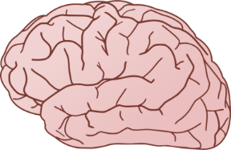
Name Tent
Front Side :
Your name, largely and clearly
4 corners:
Top Left: symbol to figuratively represent your summer
Top Right: symbol to figuratively represent something you are nervous about at SHS
Bottom Left: symbol to figuratively represent something you are good at
Bottom Right: symbol to figuratively represent the last book you read

Slide 3
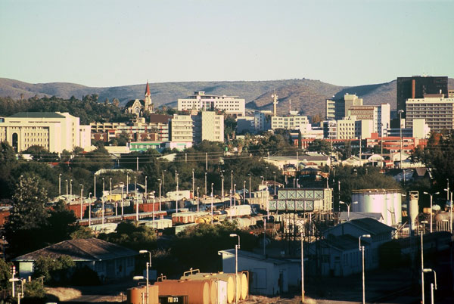
About me
Born in Cape Town, South Africa
Lived in Windhoek, Namibia
Moved to Seattle with parents, sister in 1999
Graduate of Skyline (2004)
UW for both English undergrad degree and Masters in Education
Got married July 2018
Baby Cossano due April 1st, 2020

Slide 4
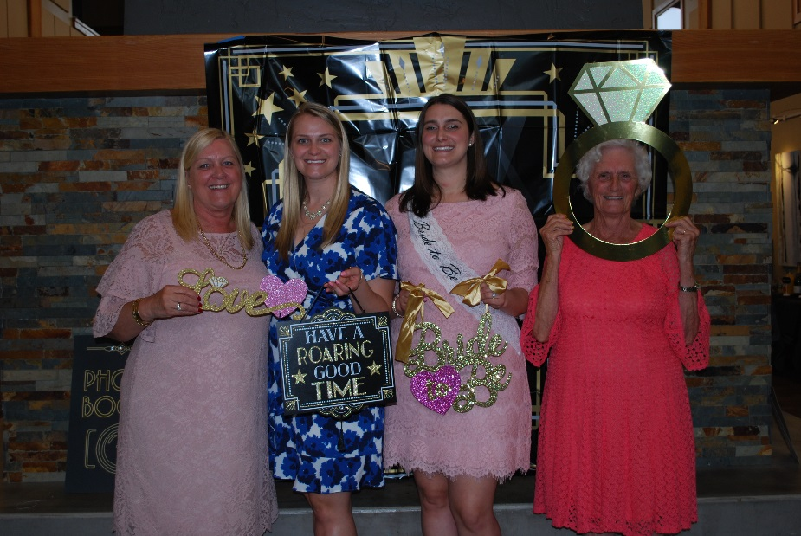

Slide 5
Why teaching?
I teach because of you.
I want all students to reach their potential and realize that they have a voice that deserves to be heard.
I teach because I love watching students grow and succeed.
I teach because it matters.

Slide 6
Getting to Know you!
Please take a few minutes to fill in the student interest survey so I can get to know you better!
Remember: I am a mandatory reporter as a school employee.

Slide 7
Creative writing
In order to be successful in the class, we need to rethink our definition of ‘school writing’.
This class is not traditional in terms of writing: more freedom, less academic restrictions!
Your task: visually define/represent the term creative writing

Slide 8
Apples to Apples
Grab one green card and one red card from the box
You must now write a short story (think a page, or 300-500 words) using the words on the card
Type and submit to turnitin.com by Friday at 10pm
That’s the directions…now go write!

Slide 9
Older files

Slide 10
Advice from famous writers
Hilary Mantel – a little arrogance can be a great help “The most helpful quality a writer can cultivate is self-confidence – arrogance, if you can manage it. You write to impose yourself on the world, and you have to believe in your own ability when the world shows no sign of agreeing with you.”
Leo Tolstoy and HP Lovecraft – pick the hours that work best for you Tolstoy believed in starting first thing: “I always write in the morning. I was pleased to hear lately that Rousseau, too, after he got up in the morning, went for a short walk and sat down to work. In the morning one’s head is particularly fresh. The best thoughts most often come in the morning after waking while still in bed or during the walk.” Or stay up late as HP Lovecraft did: “At night, when the objective world has slunk back into its cavern and left dreamers to their own, there come inspirations and capabilities impossible at any less magical and quiet hour. No one knows whether or not he is a writer unless he has tried writing at night.”
William Faulkner – read to write “Read, read, read everything – trash, classics, good and bad, and see how they do it. Just like a carpenter who works as an apprentice and studies the master. Read! You’ll absorb it. Then write. If it is good, you’ll find out. If it’s not, throw it out the window.”

Slide 11
Continued
Katherine Mansfield – writing anything is better than nothing “Looking back I imagine I was always writing. Twaddle it was too. But better far write twaddle or anything, anything, than nothing at all.”
Ernest Hemingway – stop while the going is good “Always stop while you are going good and don’t worry about it until you start to write the next day. That way your subconscious will work on it all the time. But if you think about it consciously or worry bout it you will kill it and your brain will be tired before you start.”
Miranda July – don’t worry about the bad drafts “I was a lot dumber when I was writing the novel. I felt like worse of a writer … would come home every day from my office and say, ‘Well, I still really like the story, I just wish it was better written.’ At that point, I didn’t realize I was writing a first draft. And the first draft was the hardest part. From there, it was comparatively easy. It was like I had some Play-Doh to work with and could just keep working with it – doing a million drafts and things changing radically and characters appearing and disappearing and solving mysteries: Why is this thing here? Should I just take that away? And then realizing, no, that is there, in fact, because that is the key to this. I love that sort of detective work, keeping the faith alive until all the questions have been sleuthed out.”

Slide 12
More advice
John Steinbeck – take it a page at a time “Abandon the idea that you are ever going to finish. Lose track of the 400 pages and write just one page for each day. It helps.”
Zadie Smith – get offline “Work on a computer that is disconnected from the internet.”
Muriel Spark* – get a cat “If you want to concentrate deeply on some problem, and especially on some piece of writing or paper-work, you should acquire a cat. Alone with the cat in the room where you work … the cat will invariably get up on your desk and settle under the desk lamp. The light from a lamp … gives the cat great satisfaction. The cat will settle down and be serene, with a serenity that passes all understanding. And the tranquility of the cat will gradually come to affect you, sitting there at your desk, so that all the excitable qualities that impeded your concentration compose themselves and give your mind back the self-command it has lost. You need not watch the cat all the time. Its presence alone is enough. The effect of a cat on your concentration is remarkable, and very mysterious.”

Slide 13
Kurt Vonnegut
Kurt Vonnegut created some of the most outrageously memorable novels of our time, such as Cat's Cradle, Breakfast Of Champions, and Slaughterhouse Five.
“His work is a mesh of contradictions: both science fiction and literary, dark and funny, classic and counter-culture, warm-blooded and very cool. And it's all completely unique”.
Taken from: Gotham Writers (writingclasses.com)

Slide 14
Creative Writing 101
Use the time of a total stranger in such a way that he or she will not feel the time was wasted.
Give the reader at least one character he or she can root for.
Every character should want something, even if it is only a glass of water.
Every sentence must do one of two things—reveal character or advance the action.
Start as close to the end as possible.

Slide 15
Creative writing 101
Be a sadist. No matter how sweet and innocent your leading characters, make awful things happen to them—in order that the reader may see what they are made of.
Write to please just one person. If you open a window and make love to the world, so to speak, your story will get pneumonia.
Give your readers as much information as possible as soon as possible. To heck with suspense. Readers should have such complete understanding of what is going on, where and why, that they could finish the story themselves, should cockroaches eat the last few pages.

