Slide 1
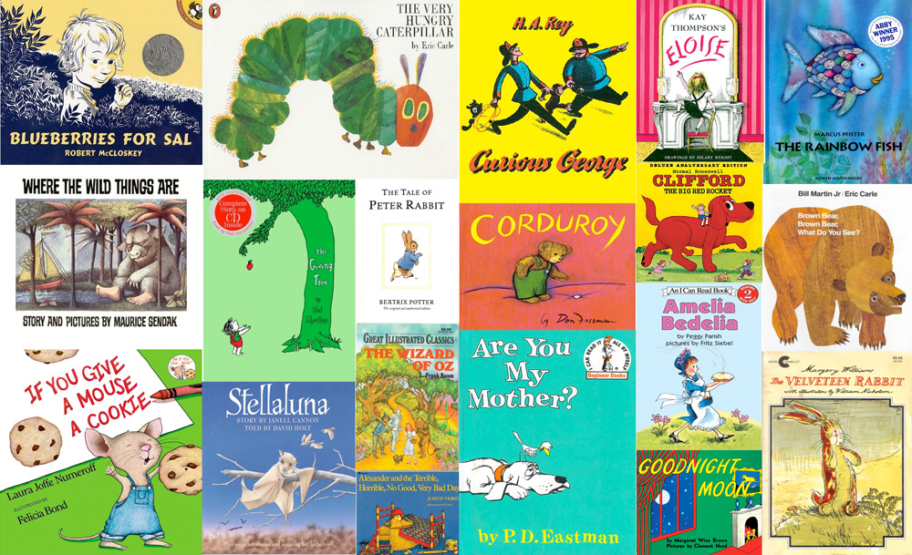
Children’s Book
Creative Writing Final

Slide 2
What is a children’s book?
What characters?
Story/plot?
Word choice?
Other requirements?
What is your favorite children’s book and why?

Slide 3
Your Task
As your culminating project and final exam in this class, you will create a children’s story of at least 15 pages (if you do this with a partner, you should do 20 pages) of text/pictures. (This does not include cover pages, about the author(s) page, back page, etc.).
You should have a look at children’s books and see how they are generally laid out (i.e. a little bit text with a picture, clear content and plots, etc.)
You will create an appropriate story with positive themes as well as reading and writing skills and/or life skills for kids to pick up on/learn. (For example you might do a book with all “R” words or all synonyms, etc.).
To do this you should draw on skills we have picked up in multiple units—you should think of a good lead, have dynamic characters, and even use well written and appropriate words and figures of speech as we discussed in our poetry unit.

Slide 4
Format
Due to online/remote learning, this children’s book will be created online. I would suggest a PowerPoint of Google Slides presentation, but if you have another format you prefer, you can use that.
Please make sure that the children’s book can be uploaded to turnitin.com.
This can be done either alone or with a partner (if that is possible for you)

Slide 5
Required Elements
Cover page
Back page
About the Authors page
Illustrations and words on each page
Page numbers
Creative title
Not in black and white
15 pages (if you do this with a partner, you should do 20 pages)

Slide 6
Things to Consider
Audience. Keep in mind that you are creating an age appropriate story book for 3 through 7-year-olds (pre-school age into 2nd grade). Excessive gore or horror is inappropriate for these ages. Your secondary audience consists of teachers and parents.
Visually-pleasing, simple, clear, understandable, and practical.
Will any attached object pose a hazard or be swallowed?
Will the book hold up through many kids’ sticky fingers or sharp, protruding staple ends hurt children?
“Test drive” presenting your creative book to an imaginary audience. Is your binding method conducive to your successful reading?

Slide 7
About the Author Page
For an About the Author page, you should include things like:
Author names
Plans for the future
Interests/hobbies
This can be funny or serious, and does not need to be a page long description. A few sentences will be fine.

Slide 8
Grading
Category | Expert | Mastery | Summary | Incomplete
Creativity | Writing piece, characters, setting, plot are exceptionally creative. | Writing piece, characters, setting are creative, avoids being formulaic. | Writing piece attempts creativity, but might be formulaic in places. | See the teacher to discuss what appears to be misunderstanding of the criteria for this category.
Originality | Writing piece (including characters, setting, plot) is exceptionally original, something unexpected and unique. | Writing piece (including characters, setting, plot) is original, with very few pieces that are expected and most aspects are unique. | Writing piece (including characters, setting, plot) attempts originality, but many aspects are expected and not unique. | See the teacher to discuss what appears to be misunderstanding of the criteria for this category.
Writing Style/Structure | Paper is readable, follows appropriate rules for creative writing submission. Grammar, spelling and punctuation are sound. Voice is present, strong and appropriate for the assignment | Paper has errors in grammar/spelling and convention, which do not impact the readability of the paper, and are infrequent. | Significant errors in grammar, spelling and convention make the paper difficult to read or create room for misunderstanding . Voice is inappropriate for the assignment, but not offensive. | See the teacher to discuss what appears to be misunderstanding of the criteria for this category
Meets Requirements | Meets and exceeds all the requirements including page/word limit, plot, characters, story structure and elements. | Meets all the requirements including page/word limit, plot, characters, story structure and elements. | Many requirements are not met, including page/word limit, plot, characters, story structure and elements. | See the teacher to discuss what appears to be misunderstanding of the criteria for this category

