Slide 1
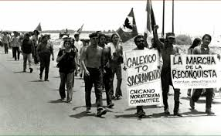
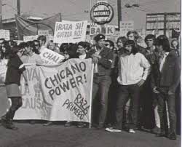
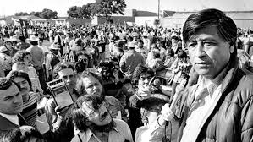
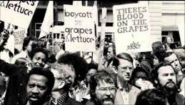
Chicano Civil Rights Movement of the 1960s

Slide 2
Learning Targets
I can determine the purpose of the Chicano Civil Rights Movement
I can examine primary source documents
I can evaluate the success of the Chicano Civil Rights Movement

Slide 3
background
The conflict between Chicanos and the LAPD thus helped Mexican Americans develop a new political consciousness that included a greater sense of ethnic solidarity, an acknowledgment of their subordinated status in American society, and a greater determination to act politically, and perhaps even violently, to end that subordination. While most people of Mexican descent still refused to call themselves Chicanos, many had come to adopt many of the principles intrinsic in the concept of chicanismo.
The Journal of American History, Edward J. Escobar

Slide 4
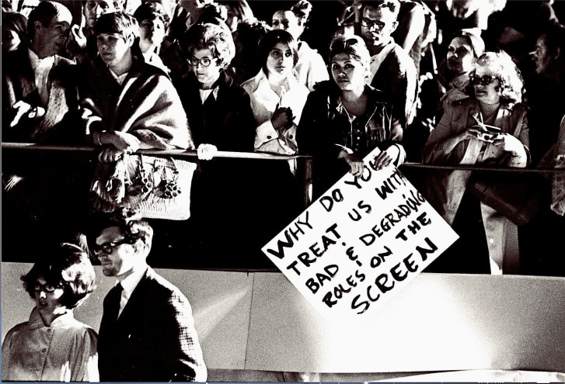
Background and intent
The movement aimed to:
Restore land grants,
Ensure and enforce farm workers' rights,
Improve education,
Get voting rights
Challenge and correct political ethnic stereotypes of Mexicans in mass media and the American consciousness

Slide 5
Early foundation
1947 Mendez v. Westminster court case ruling which declared that segregating children of "Mexican and Latin descent" was unconstitutional
1954 Hernandez v. Texas ruling which declared that Mexican Americans and other historically-subordinated groups in the United States were entitled to equal protection under the 14th Amendment of the U.S. Constitution

Slide 6
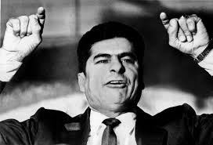
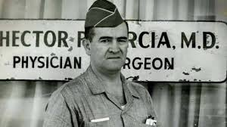
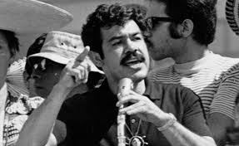
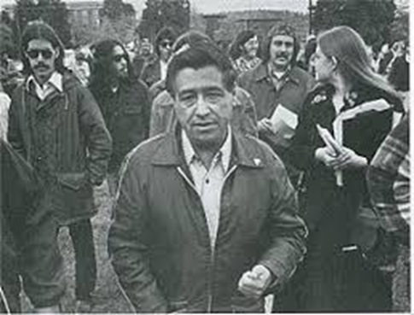
Influential leaders
Reies López Tijerina: land grant movement (New Mexico), and the Poor People’s March on Washington in 1967
Dr. Hector P. Garcia: founded American GI Forum to help returning war veterans (Texas)
Rodolfo “Corky” Gonzáles: defined the term/meaning of Chicano in Yo Soy Joaquin (I am Joaquin) poem (Colorado)
César Chávez: farmer workers who helped urban youth and worked with the La Raza Unida Party (California)

Slide 7
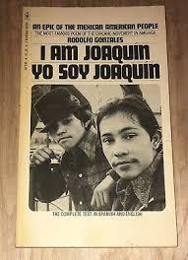
Yo Soy Joaquin (I am Joaquin )
Read the poem aloud
Please answer the following questions, typed, and submit to turnitin.com by 10pm tonight:
The purpose and intent of the poem
The message
The effectiveness of the message
The values and limitations of the poem

